Slide 1
Aircraft Instruments
Sean Tyrrell

Slide 2
Aircraft Instruments
Material you will be tested on
  Private
    http://www.tc.gc.ca/civilaviation/general/Exams/guides/tp12880/section8.htm
  Commercial
    http://www.tc.gc.ca/civilaviation/general/Exams/guides/tp12881/Section6.htm

Slide 3
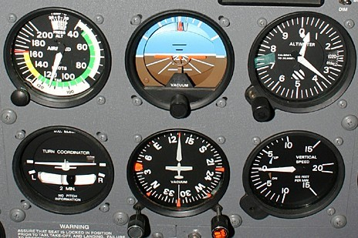
Flight Instruments
The “6 pack”

Slide 4
Pitot/Static System
What instruments are connected to the pitot/static system?
What does the pitot/static system provide to us?

Slide 5
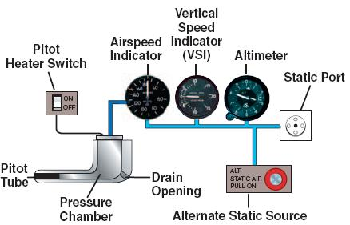
Pitot/Static System

Slide 6
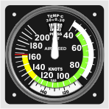
Airspeed Indicator

Slide 7
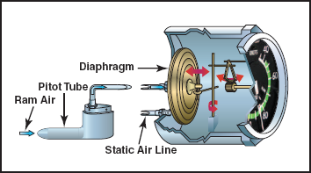
Airspeed Indicator

Slide 8
Airspeed Indicator
Compares dynamic (pitot) and static pressure sources
  Comparing this difference, the ASI can determine our speed though the air
  Diaphragm or Aneroid capsule is attached to the pitot source, the sealed case to the static pressure
    The expansion and contraction of the aneroid capsule translates into an indication on the ASI
    Essentially, the greater pressure from the ram air entering the pitot increases with airspeed, expanding the aneroid capsule and showing a speed increase
Pitot tube
  Measures dynamic and static pressure
Static port
  Measures static pressure – in order to “equalize” the static pressure reading from the pitot tube, or in other words, “subtract” it from the pitot tube static reading
Measures our airspeed through the air, not over the ground (ground speed)

Slide 9
Airspeed Indicator
IAS (indicated)
  Read directly off ASI
CAS (calibrated)
  IAS corrected for instrument and position error – most obvious at slow airspeeds
    Position error
TAS (true)
  CAS corrected for altitude and temperature (air density)

Slide 10
Airspeed Indicator
Errors
  Altitude
    Higher altitudes, airspeed indicator will not correctly read TAS – slight error due to air density
  Pitot tube
    High angles of attack can affect ram air pressure, thus causing a slight airspeed indication error
    Designers attempt to find a place where the flow of air into the pitot tube is least affected by aerodynamic effects of the aircraft
  Instrument Error
    Inherent errors present in the airspeed indicator itself
  Position Error
    Location of the static port
    Never possible to find an area of the aircraft to minimize static pressure error
    This can affect the airspeed indications at high angles of attack or if airflow is disrupted (look at the POH charts for flaps up/flaps down, aircraft is in a slip/skid)
  Blockages – Pitot/Static
    See above

Slide 11
Airspeed Indicator
V speeds
  Vne
  Vno
  Vfe
  Va
  Vs
  Vso

Slide 12
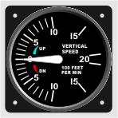
Vertical Speed Indicator

Slide 13
Vertical Speed Indicator
Only uses static pressure source
Shows the “trend” (climb or descending) and “rate” (FPM)
Measures the rate of change of pressure to determine climb or descent
Both the sealed case and the aneroid capsule are connected to static pressure
  The difference between the pressure changes in the aneroid capsule and the calibrated leak of static air into the sealed case results in a measurable expansion or contraction of the aneroid capsule
  This translates into showing a climb or descent
  When the aircraft climbs
    Pressure in the diaphragm decreases faster than that in the instrument case because the slow response of the calibrated leak – translates into a climb
  When the aircraft descends
    The pressure that enters the case through the calibrated leak is slow to respond – thus the diaphragm expands due to the increased ambient pressure from the static source and shows a descent

Slide 14
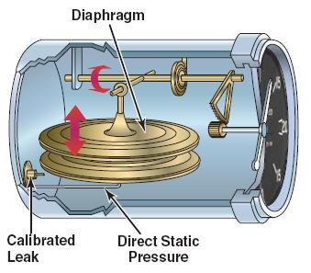
Vertical Speed Indicator

Slide 15
Vertical Speed Indicator
Lag – can be a delay of up to 6-9 seconds after a change in altitude before the VSI reads correctly
  Ex. Will still show a climb even though now levelled off from a climb
  Lag noticeable in particularly turbulent conditions
  Not advisable to use to maintain altitude, especially when flying instruments due to this lag – can cause you to have difficultly holding altitude! Use ALT instead
  Some aircraft have instantaneous VSI which eliminates this lag
Reversal – abrupt changes in altitude may cause the VSI to show a change in the wrong direction
Blocked Static?

Slide 16
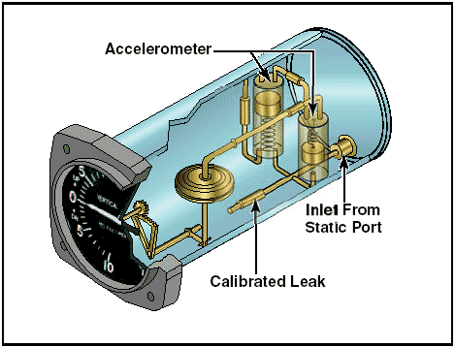
VSI

Slide 17
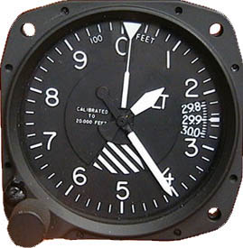
Altimeter

Slide 18
Altimeter
Only uses static pressure source
Consists of a series of sealed aneroid capsules that contain at standard sea level pressure air
  The sealed case of the altimeter is connected to our static source
  The changing pressure difference between our static port air and the sealed aneroid capsules results in a measurable expansion/contraction of the aneroid capsules
  Expansion/contraction of the aneroid capsules translates into the movement of our altimeter needle

Slide 19
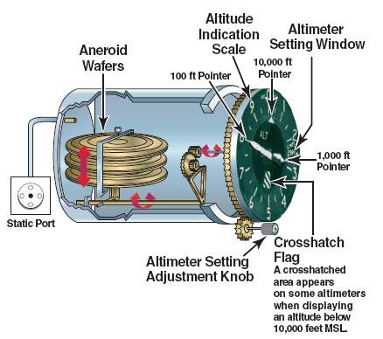
Altimeter

Slide 20
Altimeter
Errors
  Pressure changes
    As we fly, the local pressure changes and we have to reset our altimeter to the local pressure in order to be accurate in our altitude
    “low to high, clear blue sky”
      Going from a low pressure area to a high pressure area, our true altitude will be higher than our indicated altitude
    “high to low, look out below”
      Going from a high pressure area to a low pressure area, our true altitude will be lower than our indicated altitude
  Temperature
    Altimeter is set for ICAO standard temperature
      15 C at sea level, decreases 1.98 C every 1000 ft
      Ex. 5000 ft should be about 5.1 degrees in the standard atmosphere
    Colder than standard temperature for our altitude
      Our true altitude will be lower than indicated
      Ex. 5000 ft – should be 5.1 degrees, but is actually is -10
    Hotter than standard temperature for our altitude
      Our true altitude will be higher than indicated
      Ex. 5000 ft – should be 5.1 degrees, but is actually is 15

Slide 21
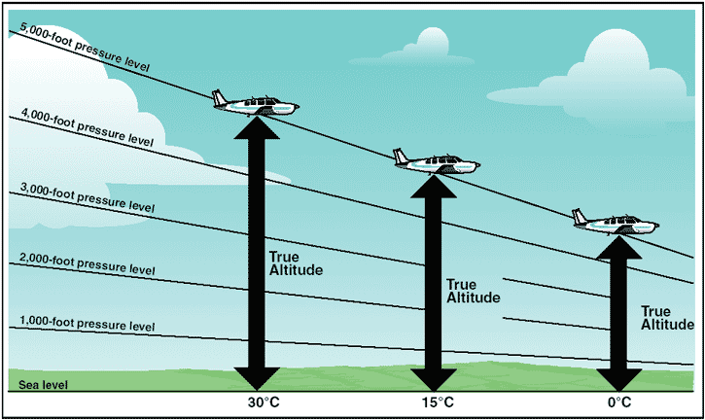
Altimeter

Slide 22
Altimeter
Errors (con’t)
  Position error
    Location of static port
    Airflow over static port can change depending on the movement/position of the aircraft
  Instrument error
    Age of instrument
    Hysterisis – lag in instrument caused by aneroid material flexing and stretching – reversal error
  Static errors/blockages

Slide 23
Pitot/Static System
Blockages
  Pitot
    Assuming pitot tube and drain hole
      Airspeed indicator now acts as altimeter
      As aircraft climbs, reads higher than actual airspeed
      As aircraft descends, reads lower than actual airspeed
      *NOTE* - if pitot tube is blocked but NOT drain hole both blocked, airspeed will go to zero
    What can you do?
      Pitot heat on
  Static
    Altimeter will freeze at the altitude that the static port became blocked
    VSI will be frozen at zero
    Airspeed will indicate
      As aircraft climbs, reads lower than actual airspeed
      As aircraft descends, reads higher than actual airspeed
    What can you do?
      Activate alternate static source (172 only)

Slide 24
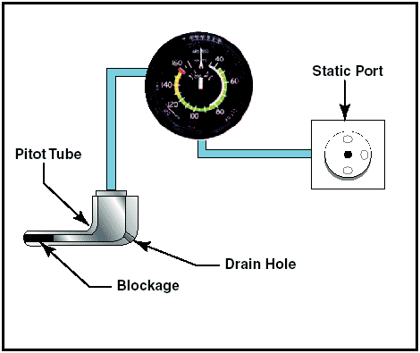
Pitot Blockage

Slide 25
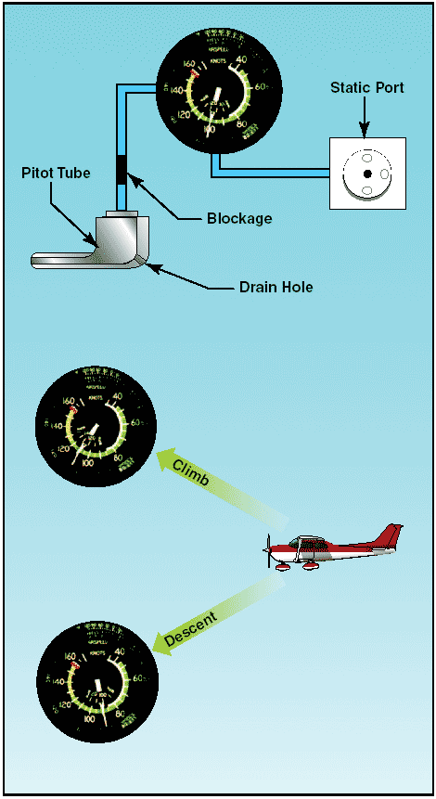
Pitot Blockage

Slide 26
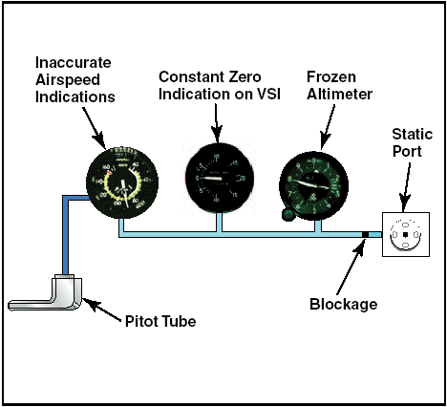
Static Blockage

Slide 27
Pitot/Static System
What can you do?
  Fly based on attitude, power setting
    Set cruise power, maintain cruise attitude
Simulator
  http://www.luizmonteiro.com/Learning_Pitot_Sim.htm

Slide 28
Pitot/Static System
TAS, CAS, IAS
True Airspeed check
  Flight test!

Slide 29
Encoding Altimeter
Encoding altimeter is found in your mode C transponder
  Provides ATC with your altitude
  Sends out altitude at standard pressure 29.92
    Radar systems compensate by adjusting value given with current station altimeter setting to get your actual altitude

Slide 30
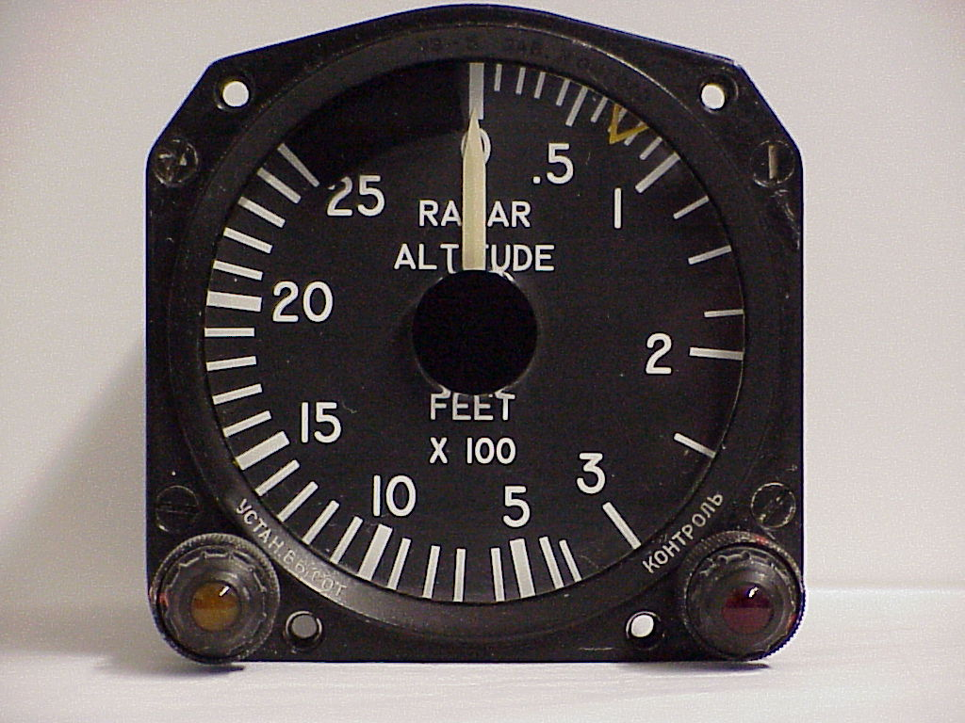
Radar Altimeter

Slide 31
Radar Altimeter
Provides height AGL
Uses radar signal that bounces off the surface of the earth and back to the receiver on the aircraft to provide height AGL
Outfitted on more advanced IFR aircraft
  Not common on light twins
Works in conjunction with GPWS to provide terrain warnings
Important in IFR situations – gives flight crews an idea of how high they are above their TD point, also plays a role in the operation of autoland systems
Limitations
  Provides height AGL only immediately in front of the aircraft – does not provide altitude of approaching terrain

Slide 32
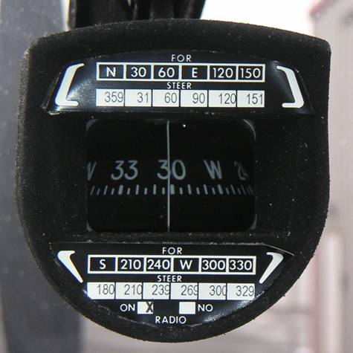
Magnetic Compass

Slide 33
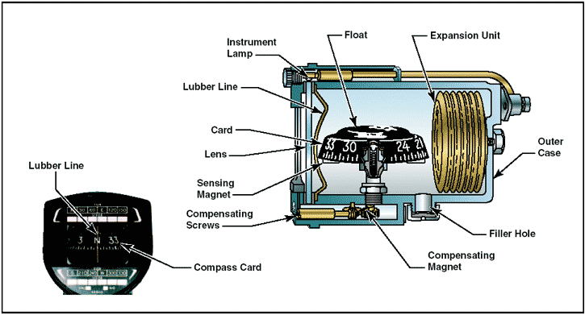
Magnetic Compass

Slide 34
Magnetic Compass
Based on magnetic field of earth
This points at magnetic north
  On our charts, these show the true north pole
Magnetic variation
  this is the difference between magnetic north we read off the compass, and true north on the chart
  Approximately 17E near Victoria
    Ex. Runway 27 is 268 degrees magnetic, but actually would be 285 degrees true

Slide 35
Magnetic Compass
Errors
  Acceleration/Deceleration
    Happens only on easterly/westerly headings
    Acceleration – compass swings to the north
    Deceleration – compass swings to the south
    ANDS
      Accelerate North, Decelerate South
  Northerly turning error
    Turns to or from the north, the compass lags behind the actual heading
    Turns to or from the south, the compass leads ahead of the actual heading
    NAGS and SEADS
      North Lags, South Leads
  Magnetic dip
    Near the poles, lines converge and compass is inaccurate – this is why in northern Canada the magnetic compass is not used
  Compass Card
    This is in the aircraft to show you the errors to the compass caused by the metal and electrics in the aircraft that cause a slight deviation in the compass readings
NOTE! We only can rely on the magnetic compass for accurate readings when we are in straight and level flight at a constant airspeed

Slide 36
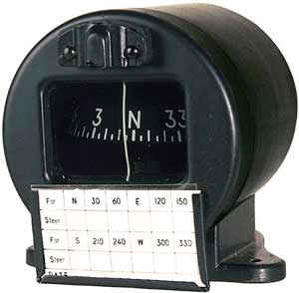
Compass Correction Card

Slide 37
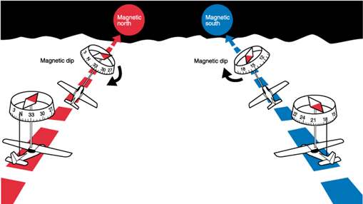
Magnetic Compass

Slide 38
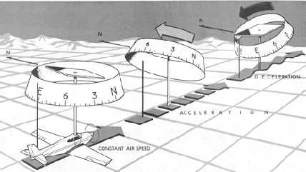
Magnetic Compass

Slide 39
Compass Swing
How often?
  Every 12 months
  Done at the compass rose located on taxiway K
  Aircraft is running during the compass swing with all systems normally used in flight powered up – we want a realistic scenario of magnetic interference from the aircraft while swinging the compass
  Adjusted via two screws that move compensating magnets

Slide 40
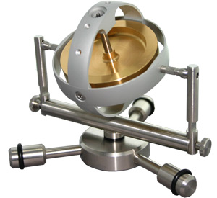
Gyroscope

Slide 41
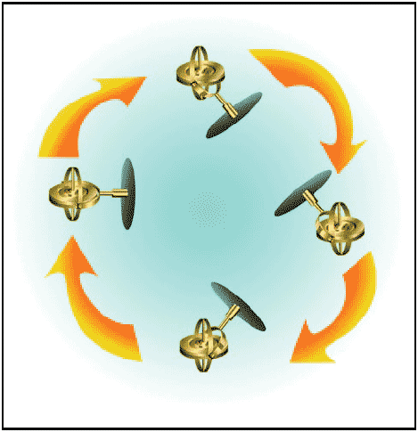
Gyroscopes

Slide 42
Gyroscope
What 3 instruments do we have gyroscopes in?
Works on the principles of “rigidity in space” and gyroscopic precession
  “rigidity in space” or gyroscopic inertia
    Defined as “the tendency of any rotating body, if undisturbed, to maintain its plane of rotation”
    Basically, this means that the spinning mass of the gyro will have the tendency to hold the same plane, despite being moved
When the gyro is spinning, it resists the tendency to move
  The aircraft moves around the gyro

Slide 43
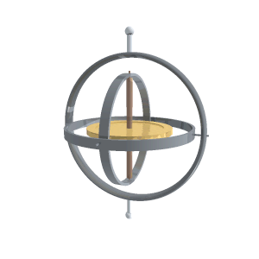
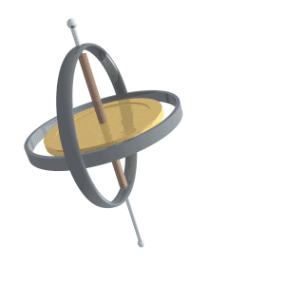
Gyroscope
A high speed spinning mass is mounted on an axis in a mounting called a gimbal

Slide 44
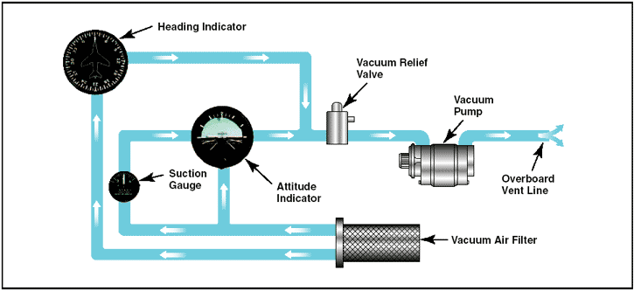
Vacuum Pump

Slide 45
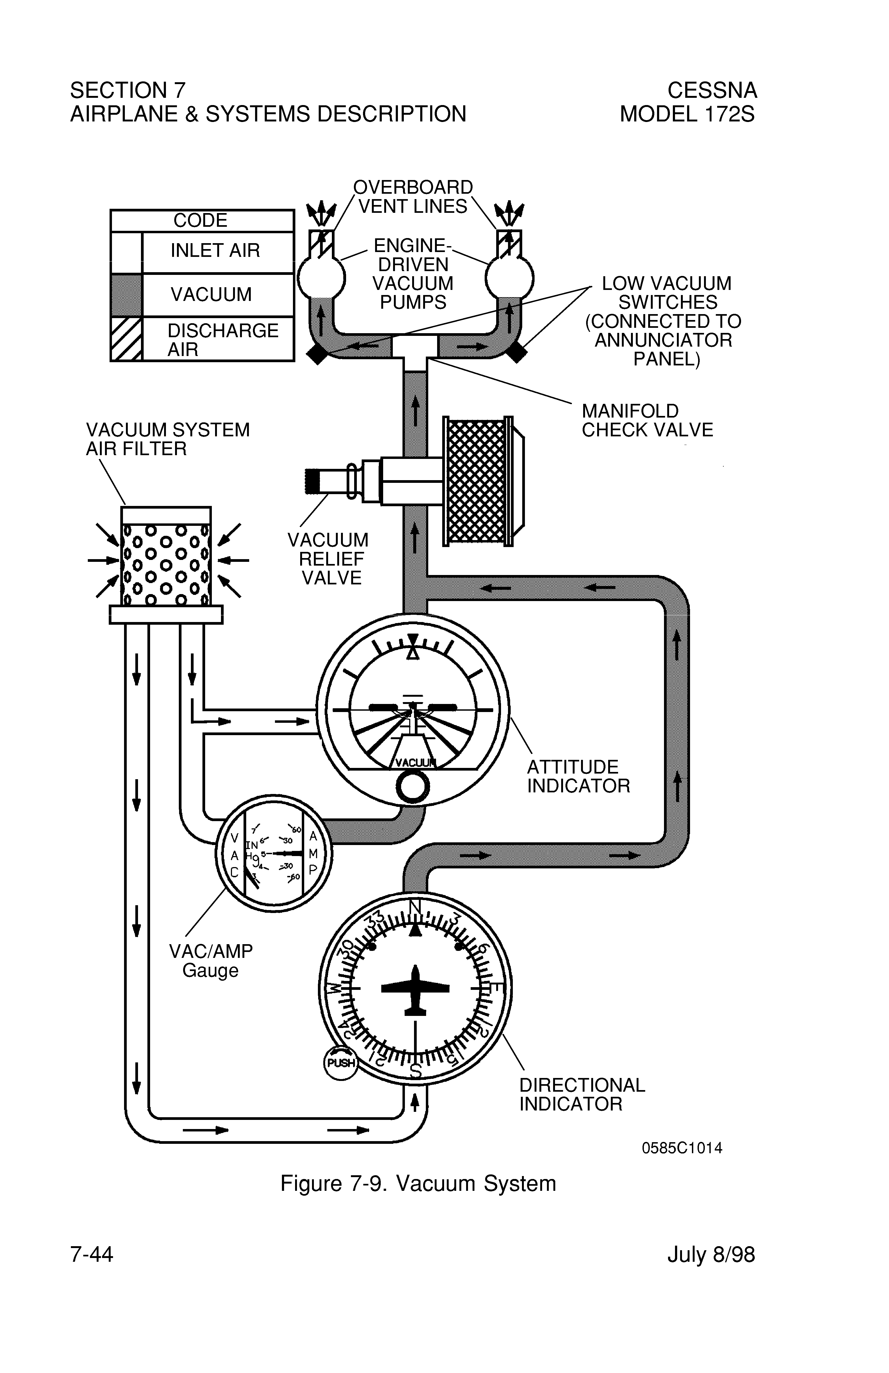

Slide 46
Vacuum Pump
An engine driven pump to provide suction power
  Drives the AI and HI in our aircraft
Not used in high altitude aircraft due to the fact that the performance decreases with altitude with the reduced air density
  Usually electrically driven in that case

Slide 47
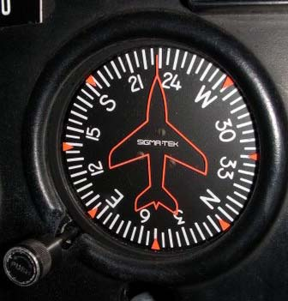
Heading Indicator

Slide 48
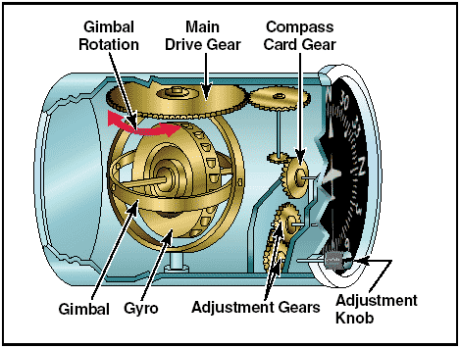
Heading Indicator

Slide 49
Heading Indicator
Steady and accurate – we set the HI to the magnetic compass
  The HI does not know our magnetic heading, we must set the HI to our compass
  We use the heading indicator as it does not have the same errors as the magnetic compass

Slide 50
Heading Indicator
The gyro is mounted vertically in a HI
  The gyro will attempt to hold its vertical position despite the motion of the aircraft
  Gyroscopic precession caused by the turning of the aircraft will tend to disturb this, and as a result, gives us an instrument indication that we are changing heading
The gyro in the HI rotates at around 20000 to 25000 RPM!
  This is driven by either a…
    Venturi
    Vacuum pump
    Electrically

Slide 51
Heading Indicator
Errors
  Apparent precession
    the rotation of the earth causes a drift in the HI setting
  Precession
    Friction in the instrument can cause the HI to lose its setting – about 3 degrees/15 minutes
    This can be worse in an older instrument that is a bit worn out

Slide 52
HSI
Slaved compass
  A flux gate sensor located often in the tail of the aircraft provides constant magnetic compass readings – this is slaved to the HSI, providing us a constant, accurate magnetic heading on our HSI
  We do not need to reset the HI to the compass with this system
Horizontal Situation Indicator
  Combines a slaved heading indicator, VOR and glideslope indicator
  Found on the Seminole
  Electrically powered

Slide 53
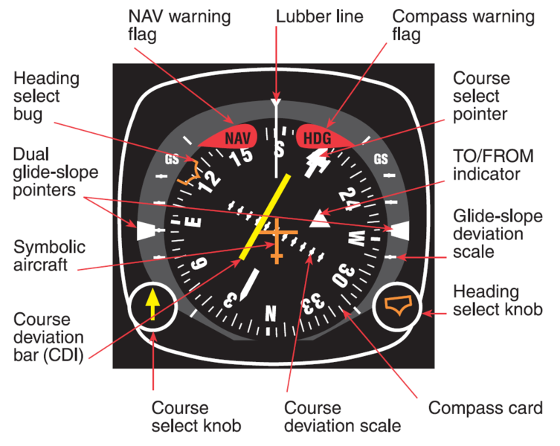
HSI

Slide 54
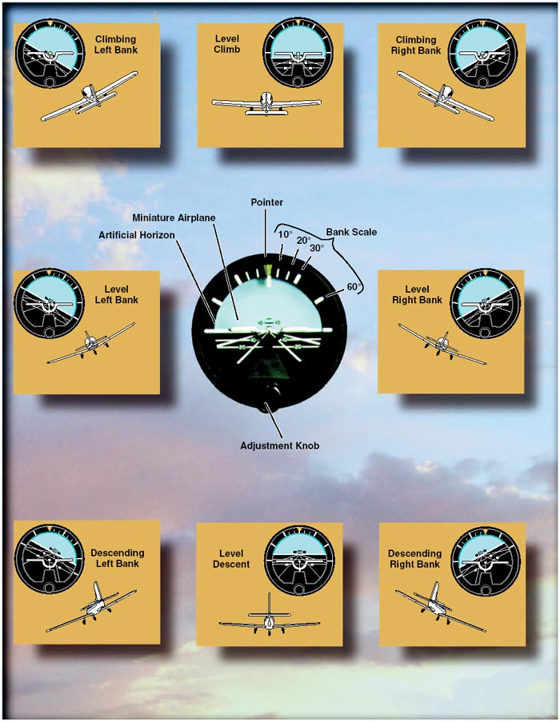
Attitude Indicator

Slide 55
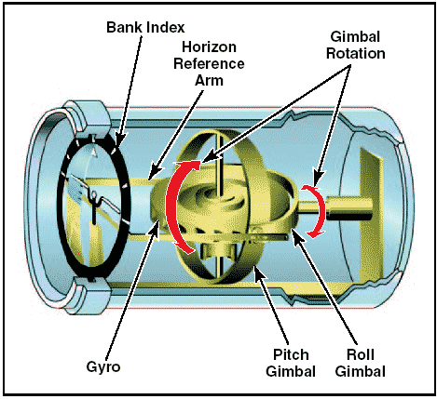
Attitude Indicator

Slide 56
Attitude Indicator
Provides us with an “artificial horizon” for circumstances where we may not be able to see the actual horizon
Uses gyroscopic principles of
  Rigidity in space
  Precession

Slide 57
Attitude Indicator
The gyro is mounted horizontally in the AI (vertically in HI)
  driven by either a…
    Venturi
    Vacuum pump
    Electrically
The gyro stays stationary, and the aircraft moves about the gyro
  The instrument translates our movement into the display that we see when the aircraft rolls and pitches
  The gyro will attempt to hold its horizontal position despite the motion of the aircraft
  Gyroscopic precession caused by the turning of the aircraft will tend to disturb this, and as a result, gives us an instrument indication that we are pitching and/or banking the aircraft

Slide 58
Attitude Indicator
Errors
  Mostly friction
  Accelation/deceleration errors
    Acceleration – shows a false pitch up indication
    Deceleration – shows a false pitch down indication

Slide 59
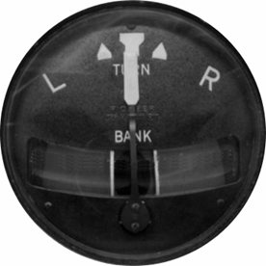
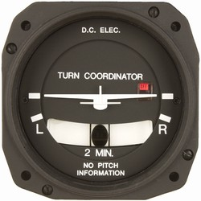
Turn and Bank Indicator / Turn Coordinator

Slide 60
Turn and Bank Indicator / Turn Coordinator
Contains a gyro – how is this gyro powered in our aircraft?
Gyro rotates at 30000 RPM
Uses gyroscopic principles of
  Rigidity in space
  Precession

Slide 61
Turn and Bank Indicator / Turn Coordinator
Also uses a steel ball in a liquid contained in a curved glass tube – inclinometer
  We use this to determine if the aircraft is slipping or skidding
Gravitational forces effect movement on the steel ball
To keep the aircraft coordinated (meaning we are eliminating the yawing of the aircraft) we “Step on the ball”
  This means if the ball is deflected to the left, we apply left rudder sufficient enough to bring the ball within the center markers

Slide 62
Turn and Bank Indicator / Turn Coordinator
Turn Coordinator
  Shows rate of turn, rate of roll and coordination
  Gyro is mounted at a 30-35 degree angle in order to provide us provide us roll information
Turn and Bank
  Shows rate of turn and coordination

Slide 63
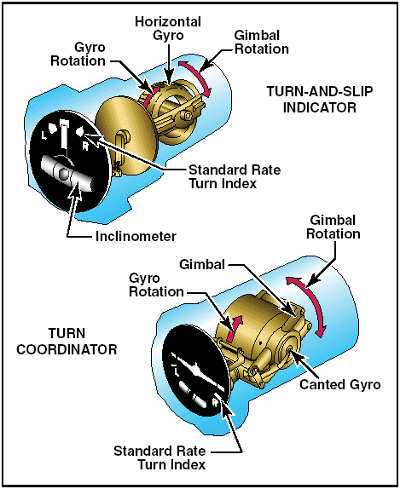
Turn and Bank / Turn Coordinator

Slide 64
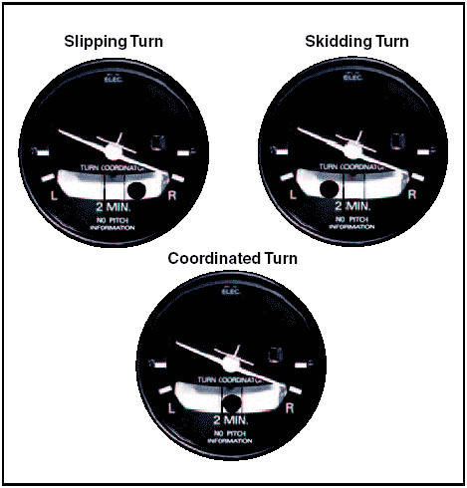
Turn and Bank Indicator / Turn Coordinator

Slide 65
Turn and Bank Indicator / Turn Coordinator
Rate one turn
  360 degrees of heading change in 2 minutes
  Turn and Bank and Turn Coordinator figure this out automatically
    As long as you keep the needle or wing of the aircraft on the mark, you will turn 360 degrees in 2 minutes
  Formula for figuring out bank angle required for rate one turn
    10% of your airspeed + 7 = angle of bank required

